Slide 1
CompSci 190: Tables & Graphs
Jeff Forbes
January 24, 2019

Slide 2
Plan For Today (PFTW)
Create tables from datafiles and other sources
Consider different methods for visualizations of data
Start working on HW 1

Slide 3

Minard’s Visualization
Napoleon's 1812 invasion of Russia
# of soldiers
direction of the march
latitude and longitude of each city
temperature on the return journey
dates

Slide 4
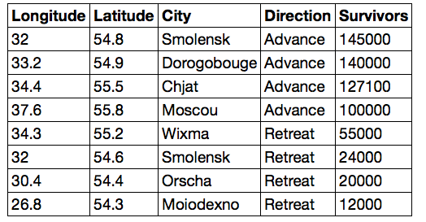
Data in a tabular form
What information does this visualization hide? What is more clear?
float:
decimal number
string:
text
int: integer

Slide 5
Table Methods
Creating and extending tables:
Table().with_columns and Table.read_table
Finding the size: t.num_rows and t.num_columns
Referring to columns: labels, relabeling, and indices
t.labels and t.relabeled; column indices start at 0
Accessing data in a column
t.column takes a label or index and returns an array
Using array methods to work with data in columns
a.item(row_index) returns a value in an array
a.sum(), a.min(), a.max() or sum(a), min(a), max(a)
Creating new tables containing some of the original columns:
select, drop

Slide 6
Manipulating Rows
t.sort(column) sorts the rows in increasing order
t.take(row_numbers) keeps the numbered rows
Each row has an index, starting at 0
t.where(column, are.condition) keeps all rows for which a column's value satisfies a condition
t.where(column, value) keeps all rows for which a column's value equals some particular value
t.with_row makes a new table that has another row

Slide 7
Decennial Census
Count how many people are in the US
U.S. Constitution. Article I, Section 2
"Representatives and direct Taxes shall be apportioned among the several States which may be included within this Union, according to their respective Numbers . . . The actual Enumeration shall be made within three Years after the first Meeting of the Congress of the United States, and within every subsequent Term of ten Years, in such Manner as they shall by Law direct.”
Census Bureau estimates the population in intervening years

Slide 8
Census Table
Values have column-dependent interpretations
The SEX column: 1 is Male, 2 is Female
The POPESTIMATE2010 column: 7/1/2010 estimate
In this table, some rows are sums of other rows
The SEX column: 0 is Total (of Male + Female)
The AGE column: 999 is Total of all ages
Numeric codes are often used for storage efficiency. Why?
Values in a column have the same type, but are not necessarily comparable (AGE 12 vs AGE 999)
http://www2.census.gov/programs-surveys/popest/datasets/2010-2015/national/asrh/ nc-est2015-agesex-res.pdf

Slide 9
What’s next?
Read Chapters 7 of Computational and Inferential Thinking
Start working on Homework 1

